Slide 1



Cover Page
Monday, 17 Nov 2025
PROJ703/ PROJ903 International Challenge Project “Eurobot”
By
ROBO-UN

Slide 2
SUMMARY
Progress Report -03
Simulation –04-05
Programming -06
Design -07
Conclusion -08
Page - 02

Slide 3
PROGRESS REPORT
What we have done:
Simulation: Add beacons, Create the TF's bridges , Fix the eagle view final position, first urdf import with (sw2urdf extension) and Assign an aruco code to the robot
Design: Refining the CAD Model and Assembly
Components: Updating the BOM
Programming: Aruco code detection
Page - 03

Slide 4
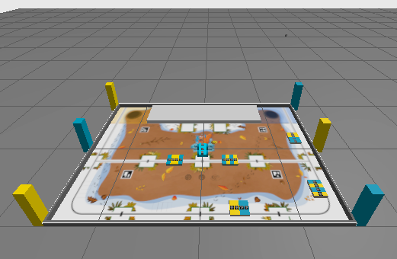
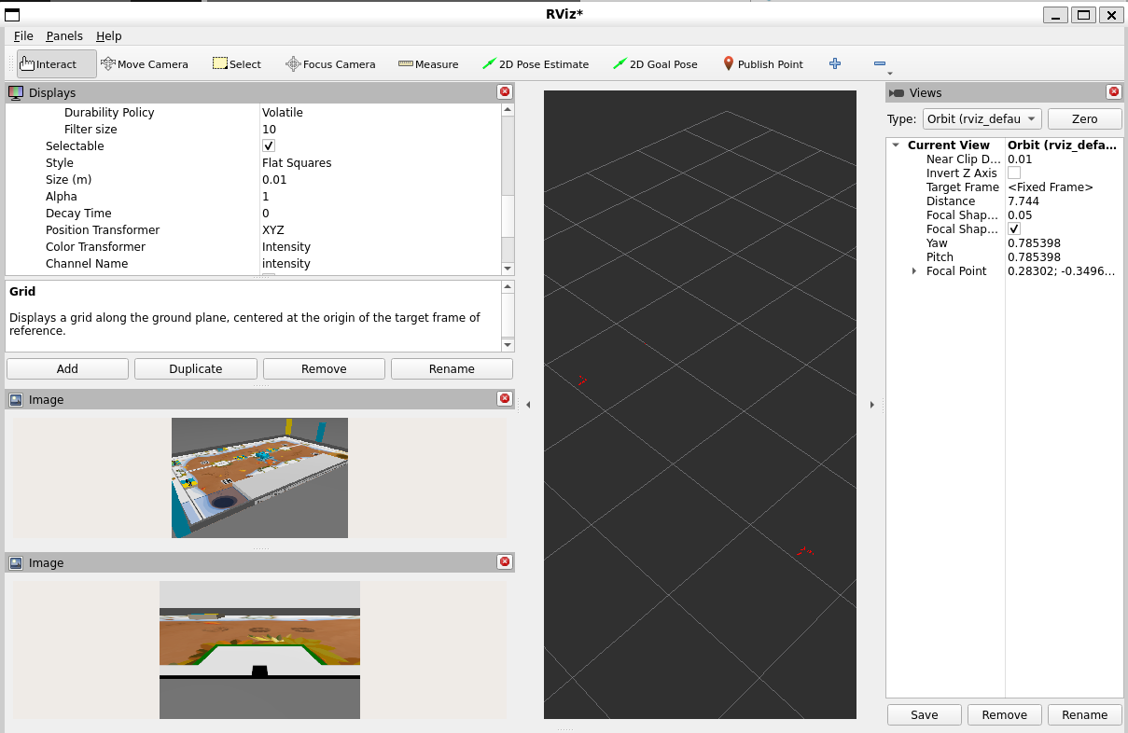
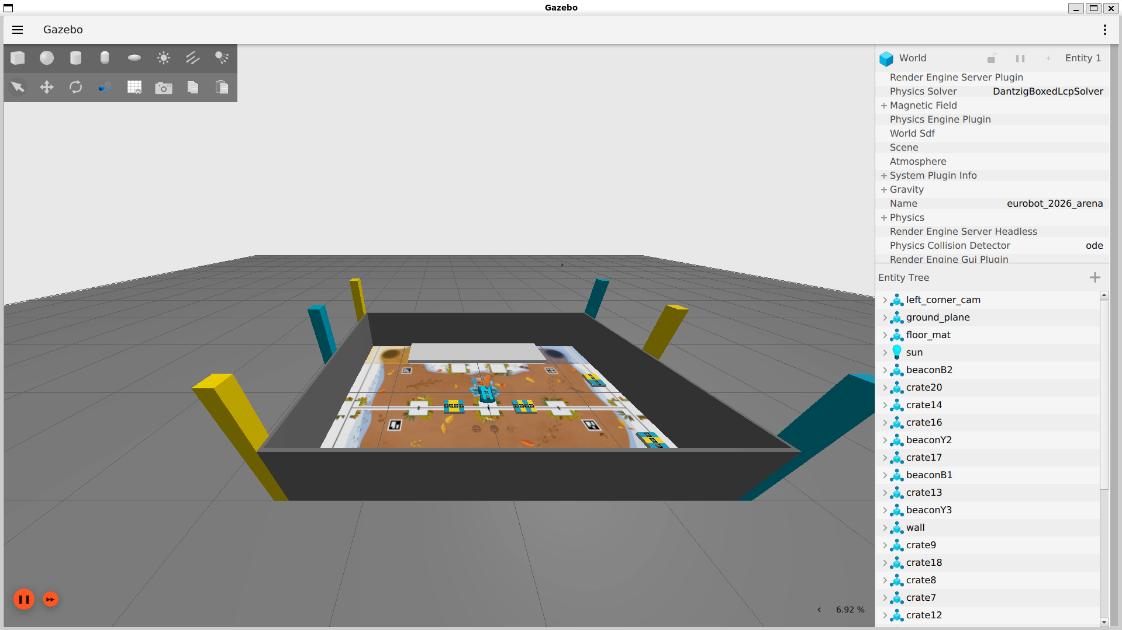
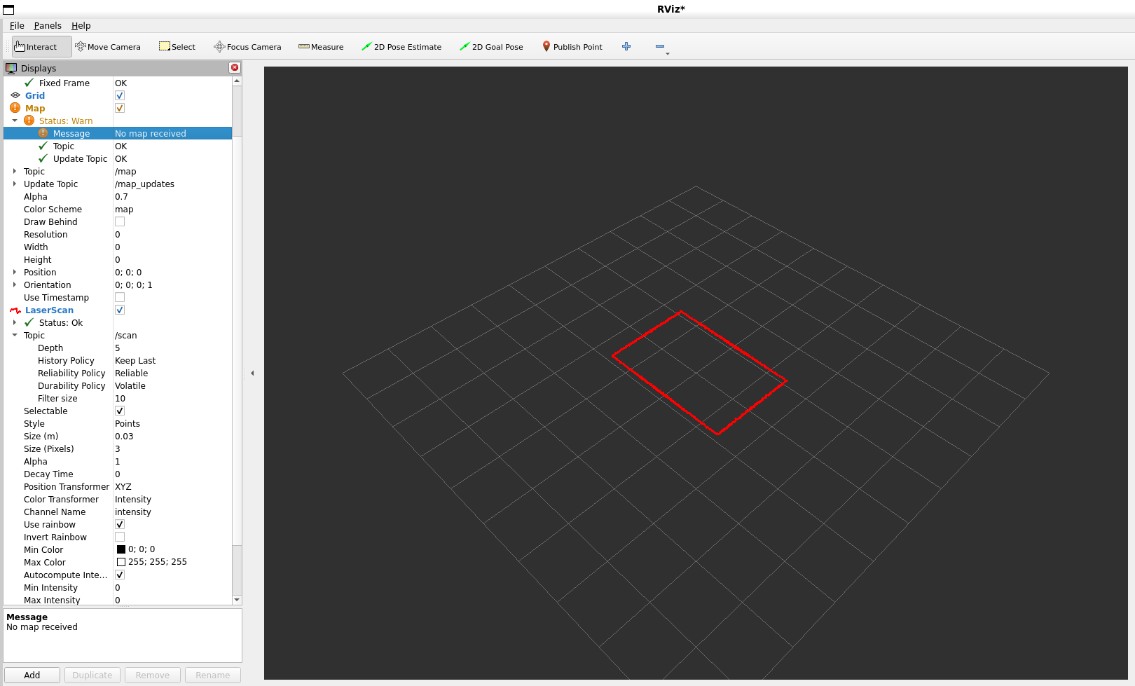
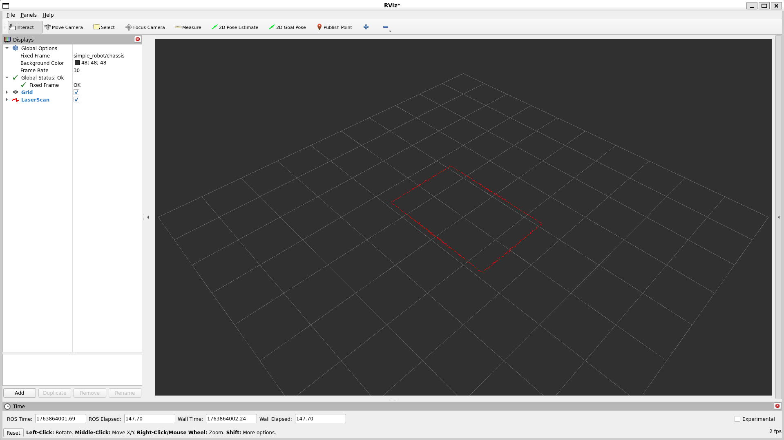
SIMULATION: Playground Environment Update
Page - 04

Slide 5
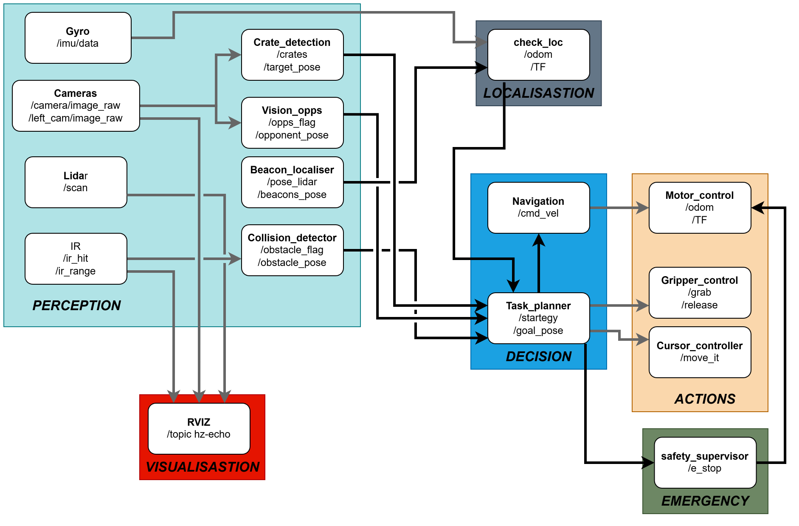
SIMULATION: ROS 2 ARCHITECTURE
Page - 05

Slide 6
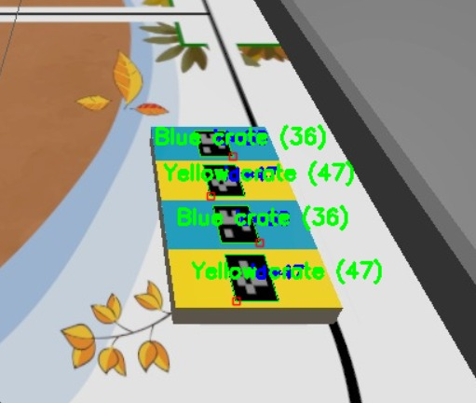
SIMULATION: Aruco detection
Page - 06

Slide 7
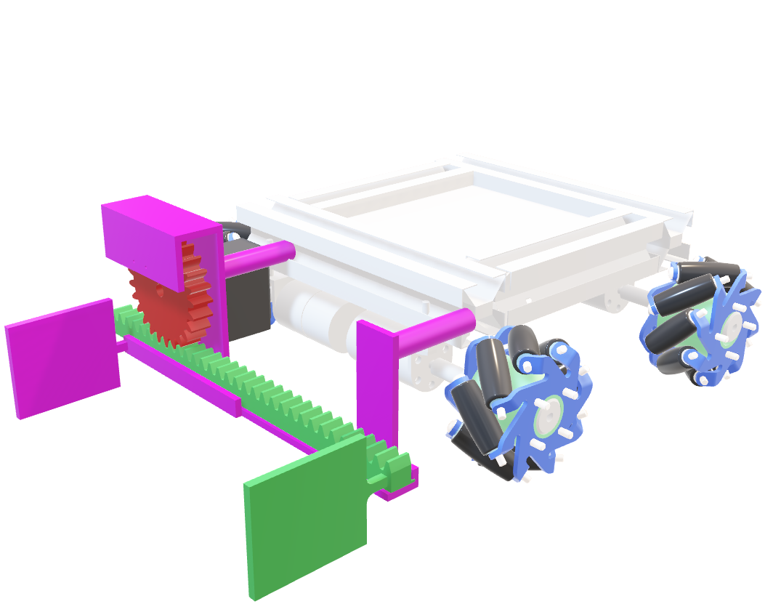
CAD Modelling
Design: Refining the CAD Model and Assembly
Design: Cursor pusher design and design other needed components and 3D printing.
Page - 07

Slide 8
CONCLUSION
What we have to do for next session:
Simulation: Develop the absolute positioning of the robot with SLAM, Get the position of crates
Design: Cursor pusher design and design other needed components and 3D printing.
Programming: Develop Aruco code detection further, integrate to simulation
Page - 8

